Slide 1

Method and means for creating anti-gravity illusion
Appl. No.: 07/905,479
Filed: June 29, 1992
Inventors: 黄义诚
Assignee: 黄义诚
Current International Class:
A43B 3/00 (20060101);
B64G 6/00 (20060101);
A43B 005/00 ();
A43B 003/00 ();

Slide 2
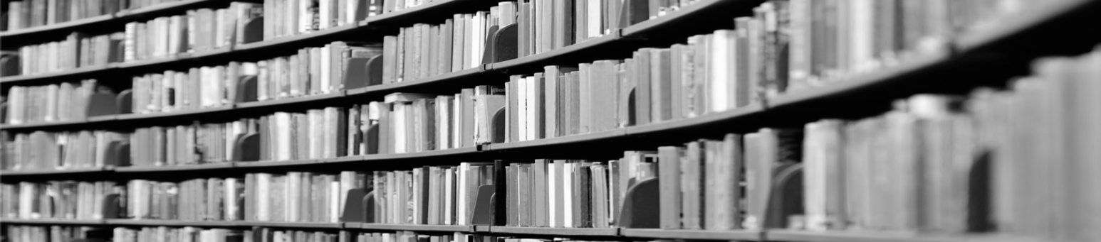
Abstract
A system for allowing a shoe wearer to lean forwardly beyond his center of gravity by virtue of wearing a specially designed pair of shoes which will engage with a hitch member movably projectable through a stage surface. The shoes have a specially designed heel slot which can be detachably engaged with the hitch member by simply sliding the shoe wearer's foot forward, thereby engaging with the hitch member.

Slide 3
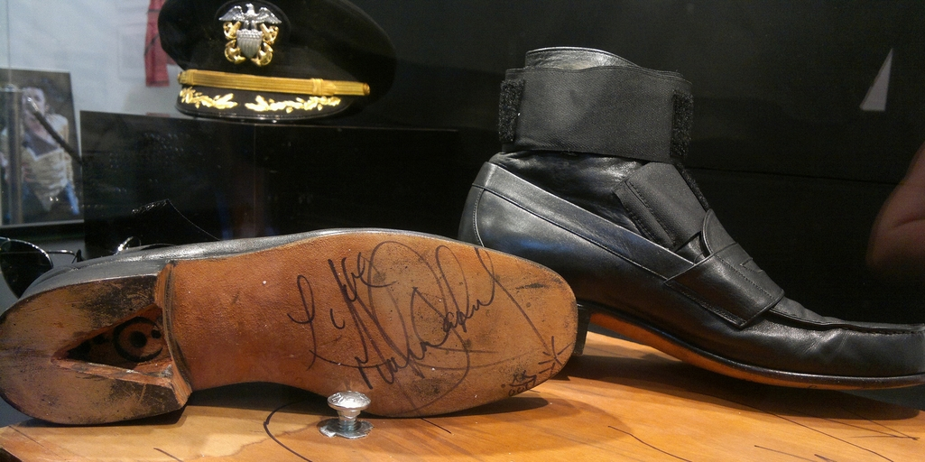

Slide 4
THANK
YOU

